Slide 1


12/05/25 - B15 LM4

Slide 2
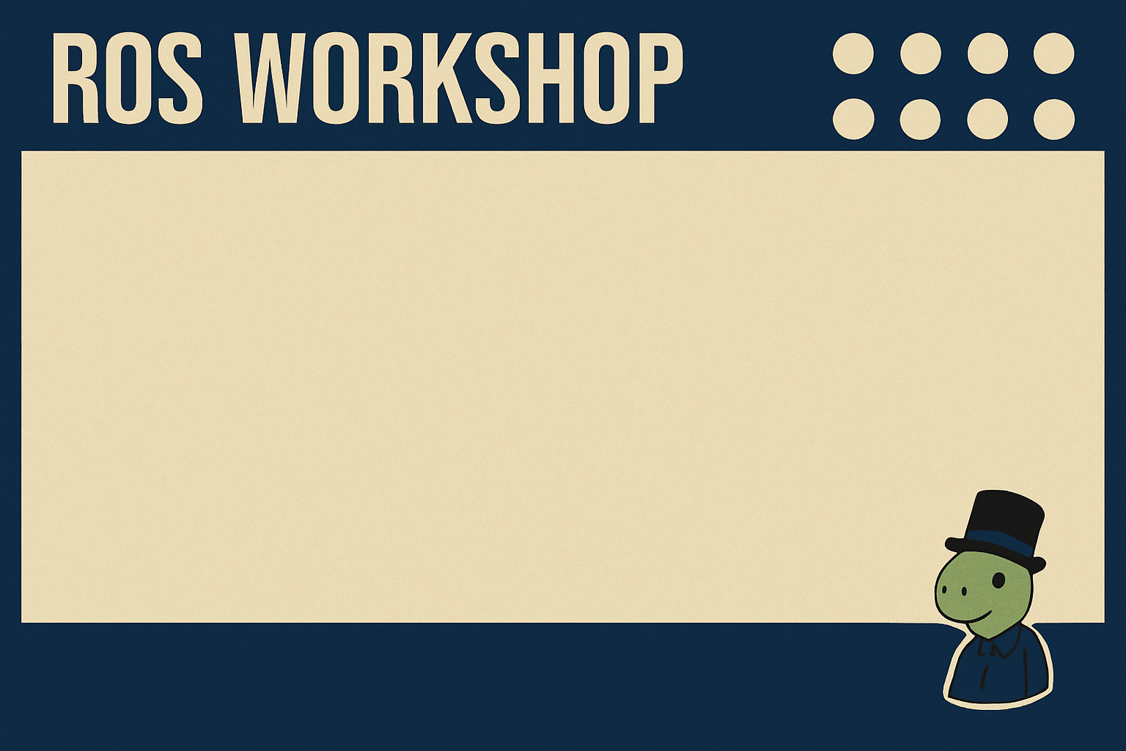
Scheduling
6th May - B15 LM4 - Introduction to the software ROS and first examples
12th May - B15 LM4 - Introduction to the GNSS module and how to use GNSS data inside ROS
16th May - B15 LM4 - Introduction to the navigation
problem and examples

Slide 3
Github link
You can download all the example from here:
https://github.com/LucaAttorrese/ROS-Workshop/tree/Rover

Slide 4
Review: pub/sub
Let’s review how to run the first example from last lesson:
Open powershell
wsl to open linux environment
Enter in tmux with: tmux
source /opt/ros/humble/setup.bash

Slide 5
Review: pub/sub
Build the package (out of package_prova folder) with: colcon build --packages-select package_prova
source ./install/setup.bash
To run the subscriber:
ros2 run package_prova Test_sub
Open a new terminal (Win/Ub: Ctrl+b then %) to run the publisher:
ros2 run package_prova Test_pub

Slide 6
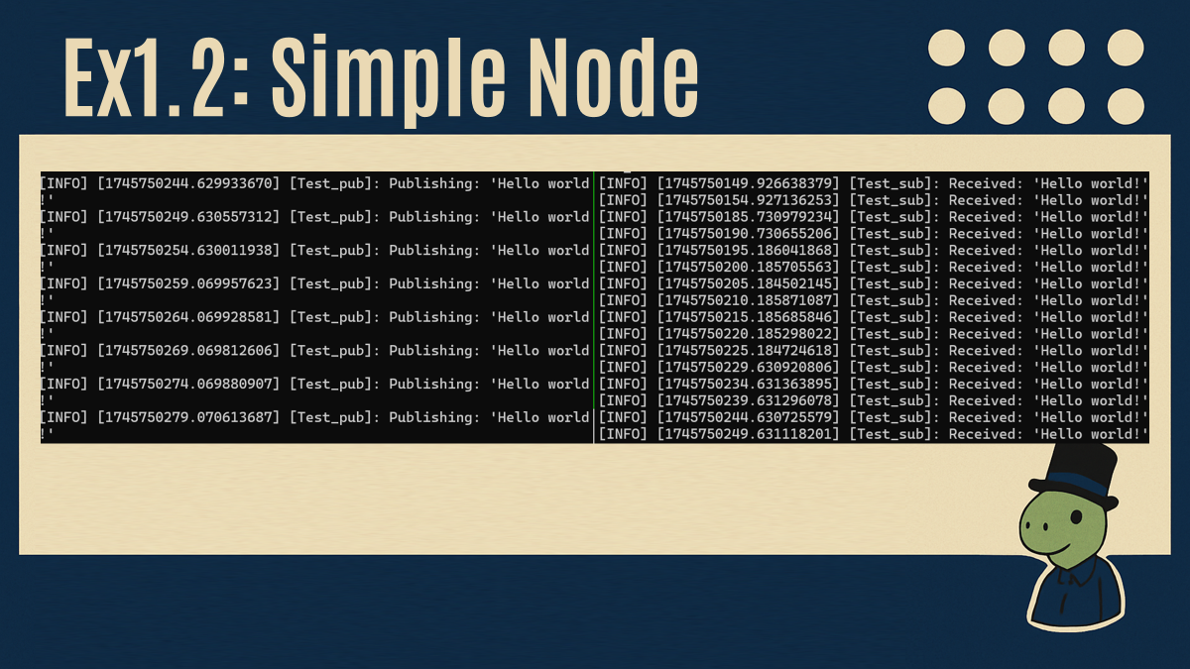

Slide 7
Ex. 1.3: Launch file
We can avoid launching the nodes one at a time by using a launch file: basically a python scripts that launches multiple nodes together.
If you want to use vim/visual studio instead of downloading from Github, follow the steps in the presentation of last week!

Slide 8
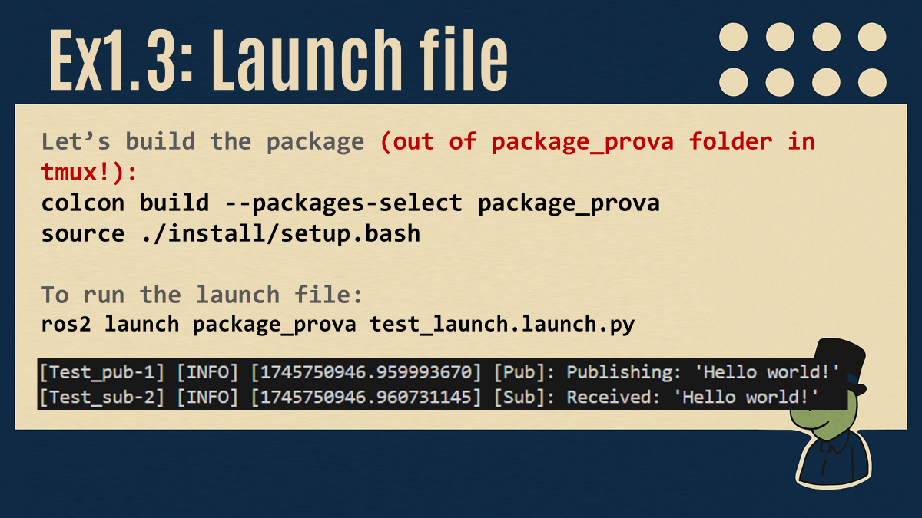
Ex. 1.3: Launch file
We can avoid launching the nodes one at a time by using a launch file: basically a python scripts that launches multiple nodes together.
If you want to use vim/visual studio instead of downloading from Github, follow the steps in the presentation of last week!

Slide 9
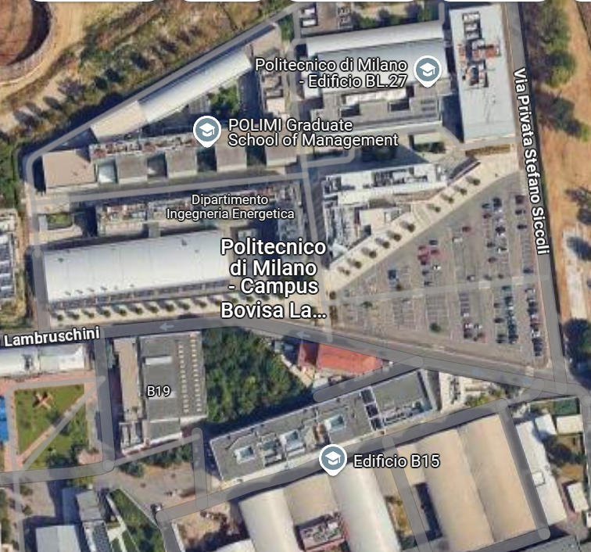

Navigation problem
Imagine to be a UAV that wants to reach a target position (BL27).

Slide 10
Navigation problem
The first step is to understand the actual position on the map.
We need a
GNSS module!

Slide 11
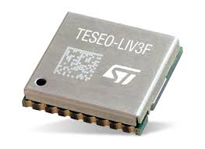
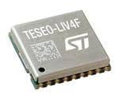
GNSS Module
Multi Constellation (GPS, Galileo BeiDou,GLONASS)
Mono band (L1)
1.5 m accuracy
Multi Constellation
Dual band (L1 & L5)
0.8 m accuracy

Slide 12
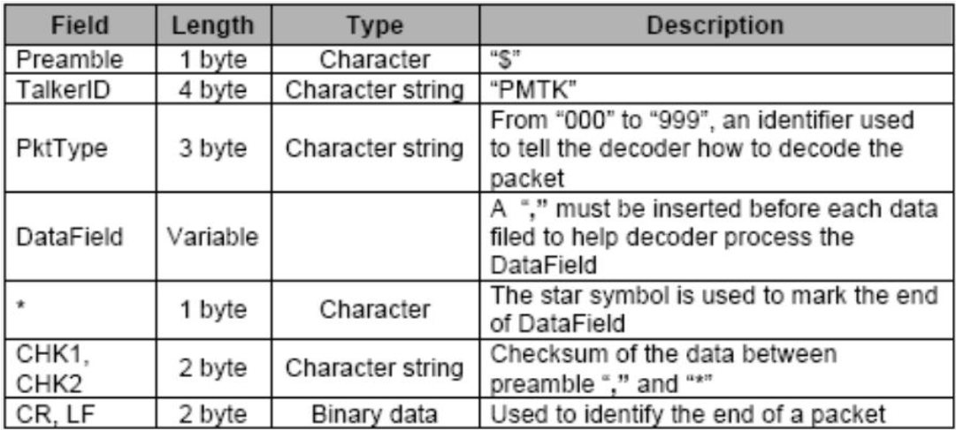
GNSS Module
>> gps.send_command(b'PMTK314,0,1,0,1,0,0,0,0,0,0,0,0,0,0,0,0,0,0,0')
GPGGA,172814.0,3723.46587704,N,12202.26957864,W,2,6,1.2,18.893,M,-25.669,M,2.0 0031*4F

Slide 13
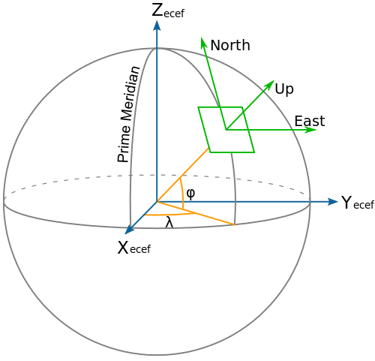
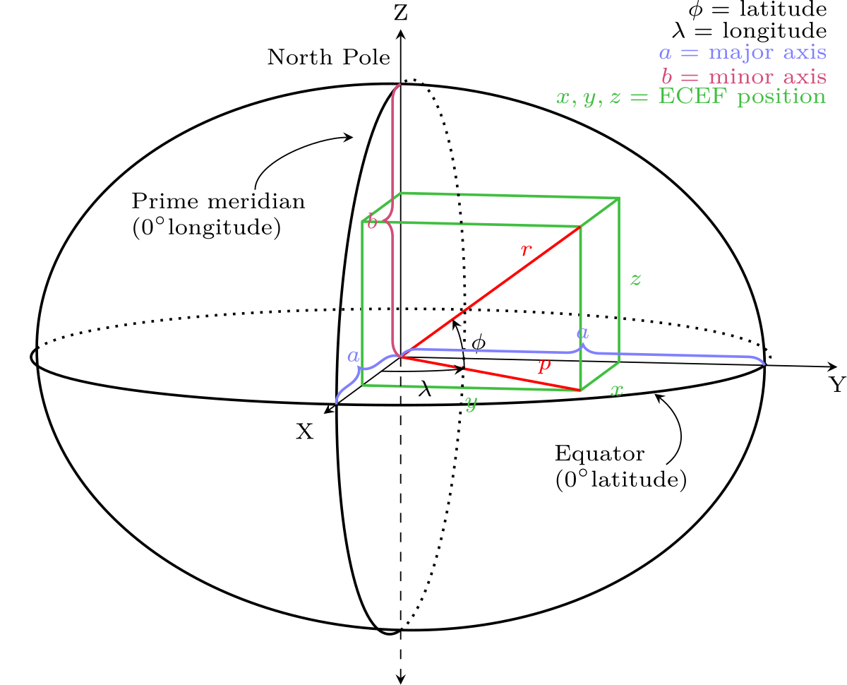
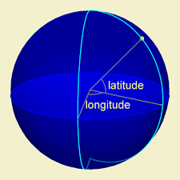
GNSS Module
LLA
Earth-Centered Earth-Fixed
ENU

Slide 14
Navigation problem
Now we know where we are (B15) and Luca gives us the trajectory, using
the library Nav2.
Now, we need to follow
the path!

Slide 15
Navigation problem
We can increase the accuracy of the measurement with sensor fusion:
Luenberger observer
Kalman filter
MHE
…

Slide 16
Why use a sensor?
Trajectory:
GNSS: noisy especially on z axis.
Accelerometer: drift.
Barometer: good for z axis correction.
Encoder: for mobile robots.
Camera: for visual odometry (computational cost)

Slide 17
Why use a sensor?
Attitude:
Gyroscope: drift
Accelerometer: can sense the gravity vector (as reaction force)
Magnetometer: can fill the north (perpendicular to g)
Camera: expensive.

Slide 18
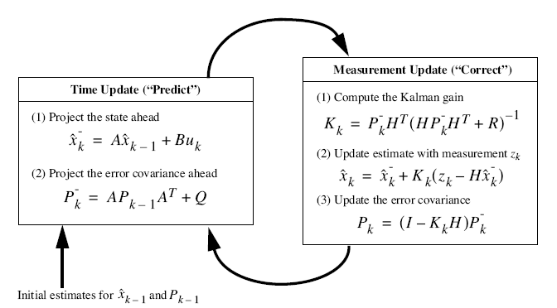
Navigation problem

Slide 19
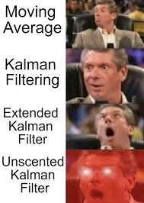
Navigation problem

Slide 20
Let’s move to ROS!

Slide 21
ROS Bag
Where to get our data? We can use a rosbag
«A bag is a file format for storing ROS messages»
It can be used to save or read data.
In the reading «option», it function as a node with multiple publishers, one for each topic
it contains

Slide 22
ROS Bag
You can find it here: https://drive.google.com/drive/folders/1_0r6vAFO9Ri0vHGDMjnbiCNLe6S428W9 (needs polispace access)
Save it inside the bags folder (you can find it in the github folder for this lecture)
Not mandatory, just to have it together with
your code

Slide 23
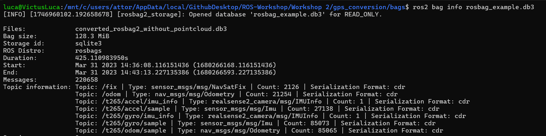
ROS Bag
How de we know which topics/messages are inside?
ros2 bag info rosbag_example.db3

Slide 24
GPS conversion
What we’ll do in this exercise?
We have gps data collected from a real robot inside the bag
We create a node that subscribes to the gps data topic
This info are then converted into odometry
data

Slide 25
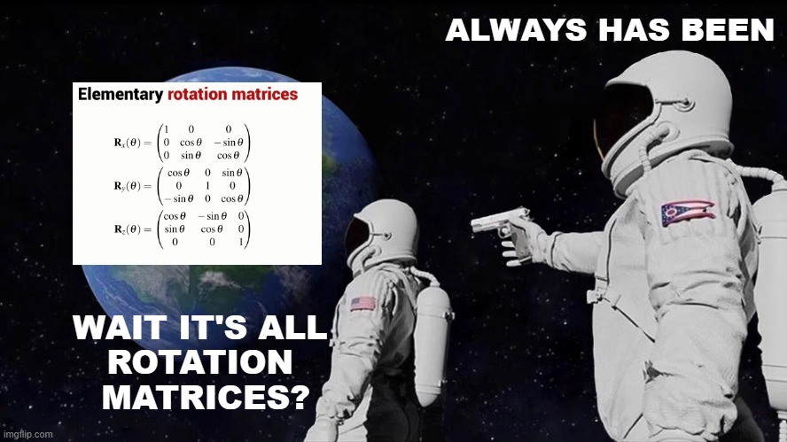
TF2
The odometry then needs to be converted from the local robot frame to the world frame.
Do you remember your rotation matrices?

Slide 26
TF2
Luckily for us, in ROS there’s a package that manages all coordinate frame transformation.
This is crucial in robotics, as usually we have a lot of local frames:
Camera
Lidar
Wheel
…

Slide 27
TF2
For this reason we tend to transform each sensor data into a common frame (usually related to the robot or to a global frame).
It’s also essential for motion planning and localization.

Slide 28
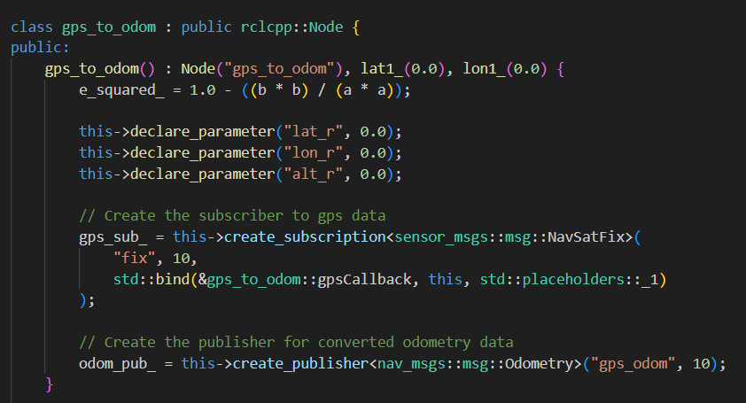
Gps_to_odom
Let’s go over the code for the gps_to_odom node.
In the public section we have a subscriber (to receive gps data) and a publisher (to send odom data).

Slide 29
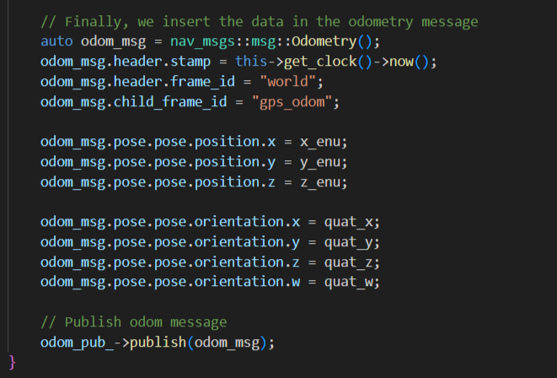
Gps_to_odom
Then, there’s a bunch of formulas to convert from LLA to ECEF to ENU. At the end of the callback, we create the payload of the odometry message.

Slide 30
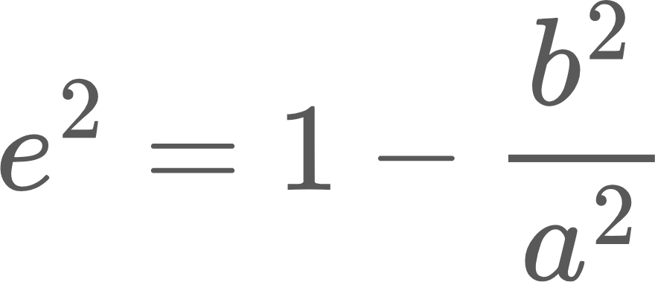
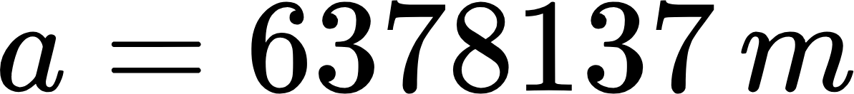
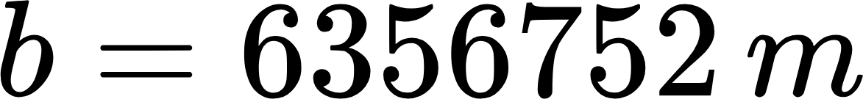
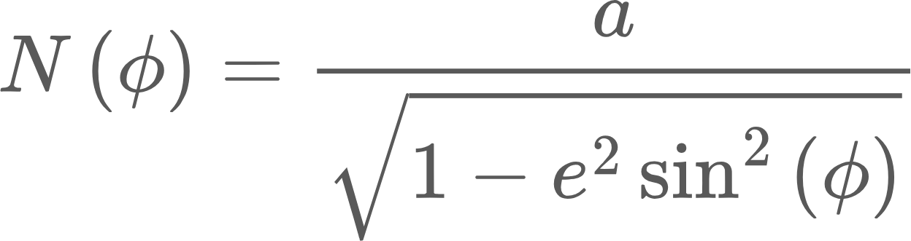
LLA to ECEF
Let’s consider the latitude (ϕ), longitude (λ) and altitude (h):

Slide 31
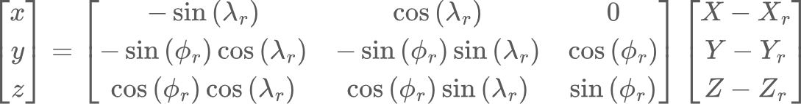
ECEF to ENU

Slide 32
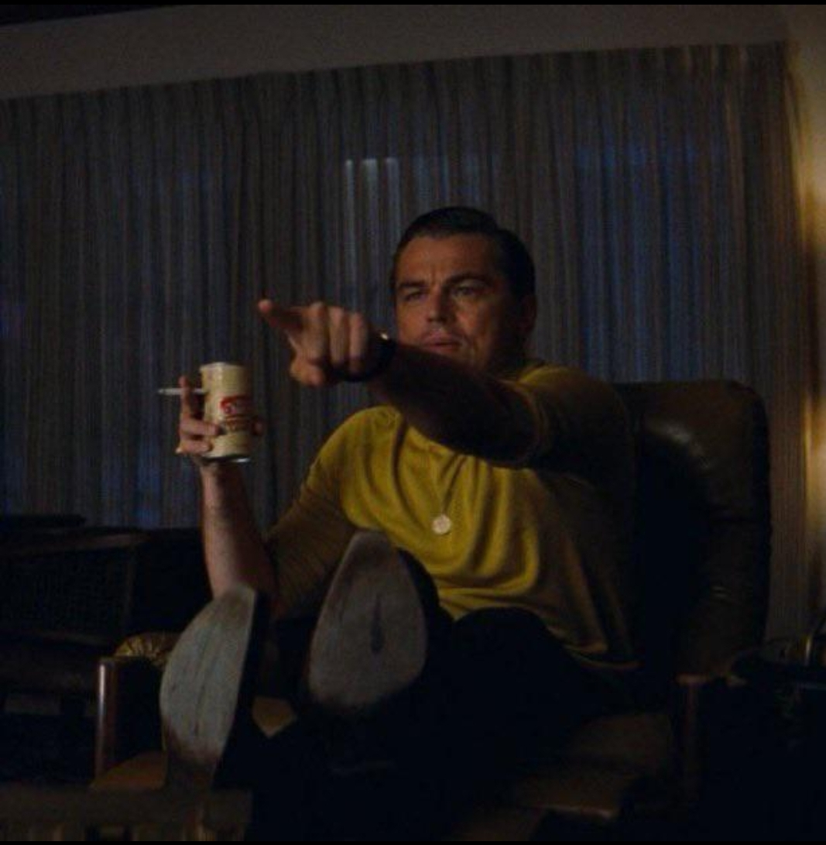
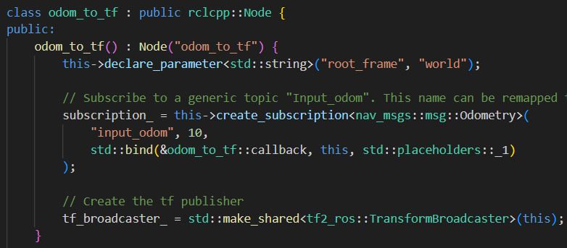
Odom_to_tf
Let’s switch to odom_to_tf node. First, we have a subscriber for odometry messages. You may notice that it subscribes to a topic «input_odom» that is not the one we defined before…

Slide 33
Odom_to_tf
…but we’ll see later why. As for the publisher, here the syntax is slightly different as it uses the one prescribed by the tf2.

Slide 34
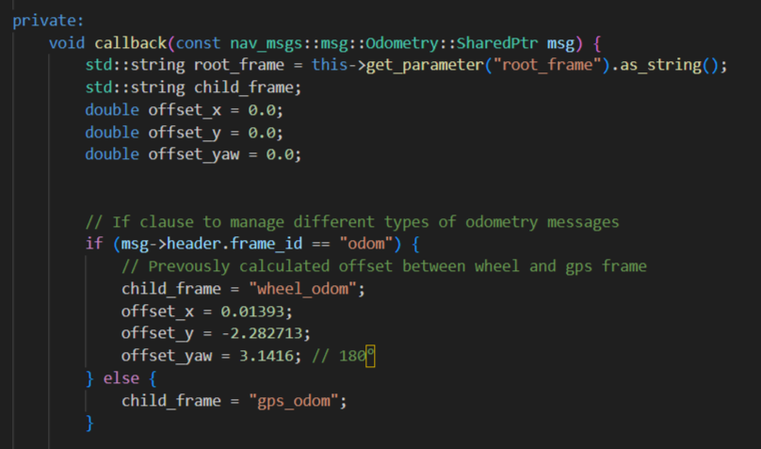
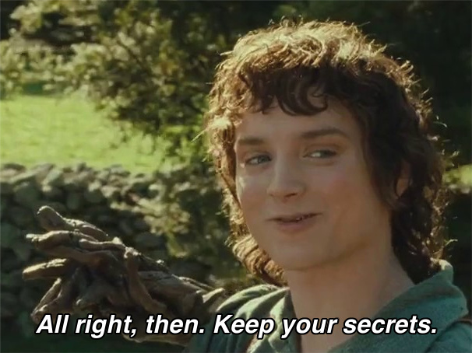
Odom_to_tf
In the callback, we define some offset parameters, depending on the frame from which we receive the message. We’ll also see the reason for this
later.

Slide 35
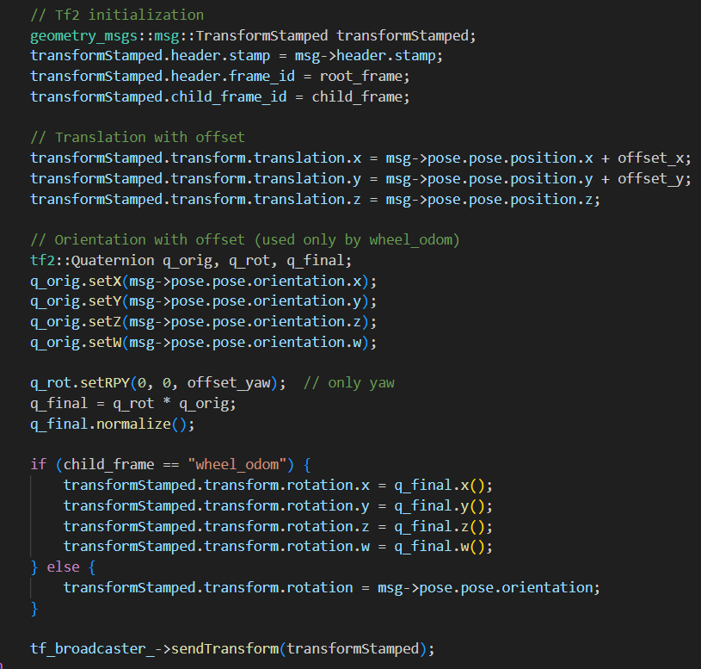
Odom_to_tf
And now we have the tf part. We are simply compiling the fields of the tf message with our data.

Slide 36
GPS_conversion
We can now launch the code. Remember to:
source /opt/ros/jazzy/setup.bash
Enter tmux: tmux
Go outside gps_conversion folder, then:
colcon build –packages-select gps_conversion
source ./install/setup.bash

Slide 37
GPS_conversion
We can now launch the code. Remember to:
source /opt/ros/humble/setup.bash
Enter tmux: tmux
Go outside gps_conversion folder, then:
colcon build –packages-select gps_conversion
source ./install/setup.bash
ros2 launch gps_conversion conversion_launch.py

Slide 38
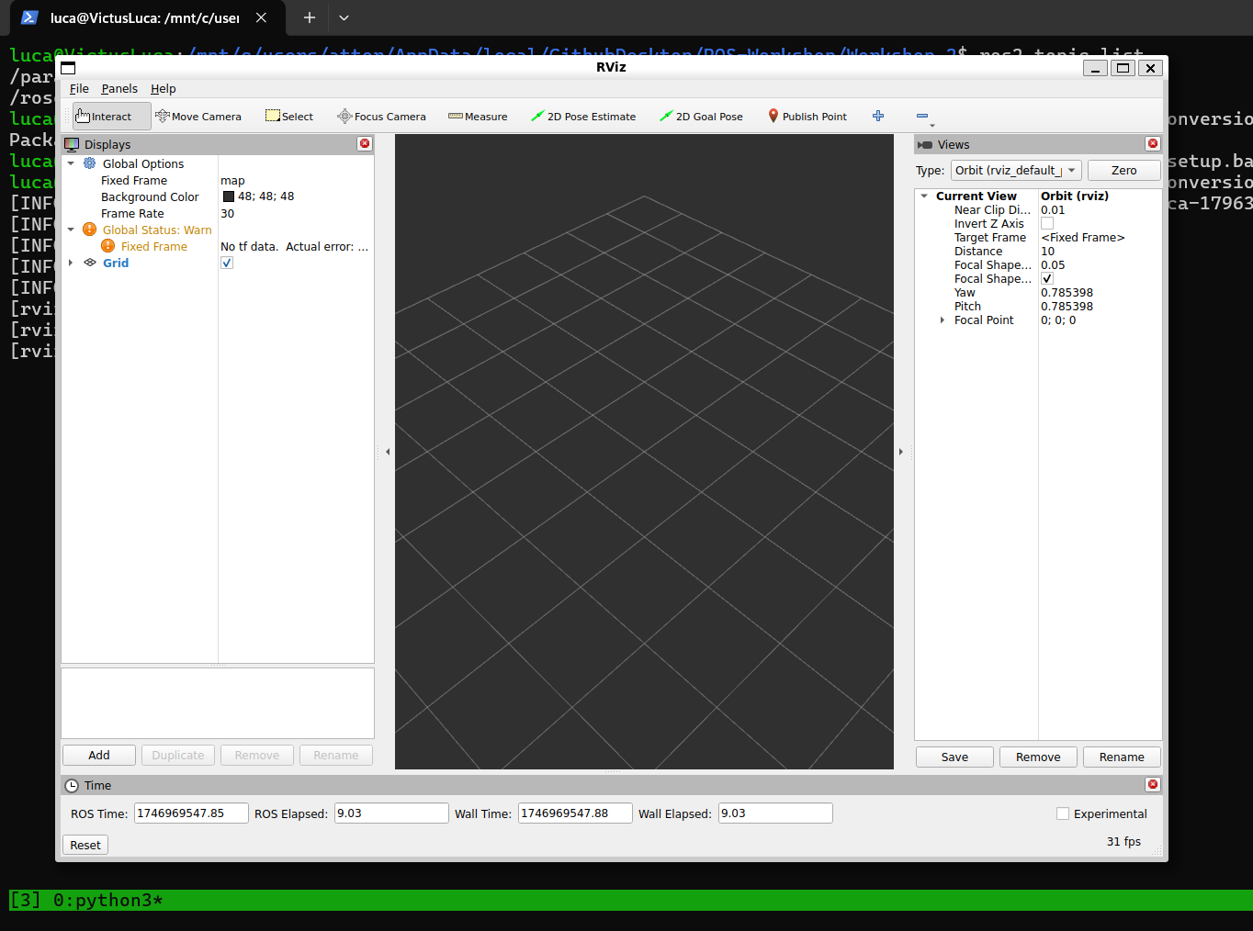
RViz
Surprise! This is RViz, a tool used for Robot visualization
You should see this:

Slide 39
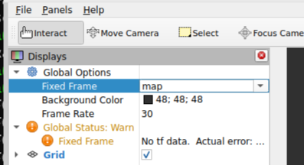
RViz
We opened it because it was declared inside the launch file.
What you’re seeing now it’s the standard configuration: let’s add something to it.
First, let’s change the frame
from the standard [map]
to our global frame [world]:

Slide 40
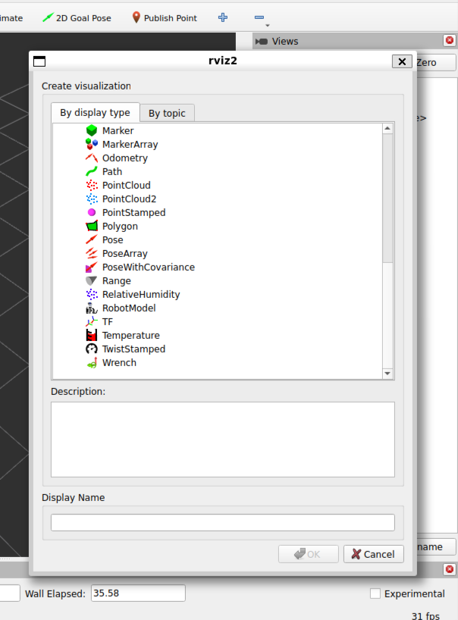
RViz
Now click on «Add» on the bottom left to add something to visualize. You should see this --->
From here, select the TF.

Slide 41
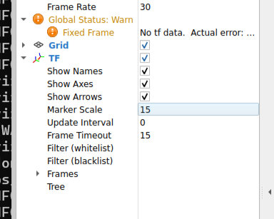
RViz
You’ll now see the TF on the left window. We can change some parameters to have a better visualization:
Show names: [on]
Marker Scale: 15 (+)

Slide 42
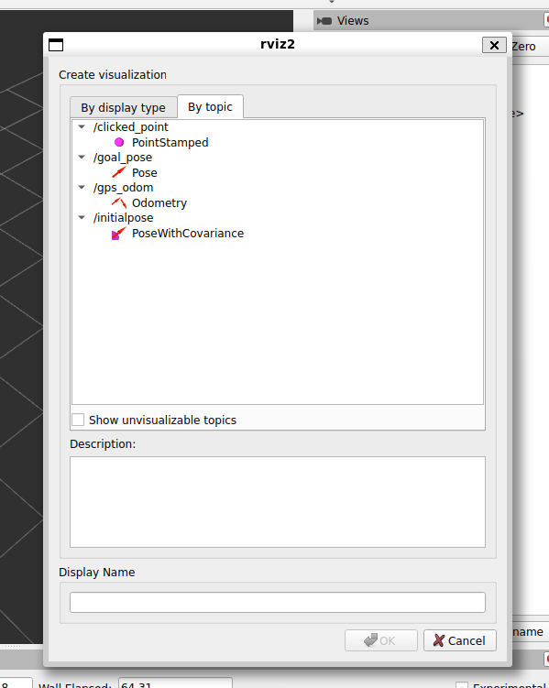
RViz
We can also visualize the odometry.
Click add and go to the «by topic» view, then select gps_odom.

Slide 43
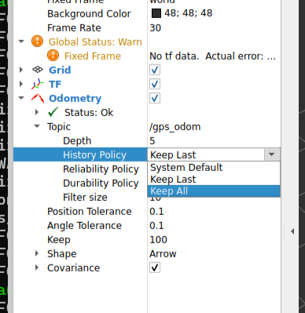
RViz
Now just change a parameter to make sure that you don’t lose any message:
History policy: [Keep All]

Slide 44
RViz
Our nodes are already running and rviz is ready, so let’s start the bag.
Open a new terminal (Win/Ub: Ctrl+b then %), go inside the bag folder (or wherever you saved the bag) and:
ros2 bag play rosbag_example.db3

Slide 45
Play the bag
Our nodes are already running and rviz is ready, so let’s start the bag.
Open a new terminal (Win/Ub: Ctrl+b then %), go inside the bag folder (or wherever you saved the bag) and:
ros2 bag play rosbag_example.db3

Slide 46
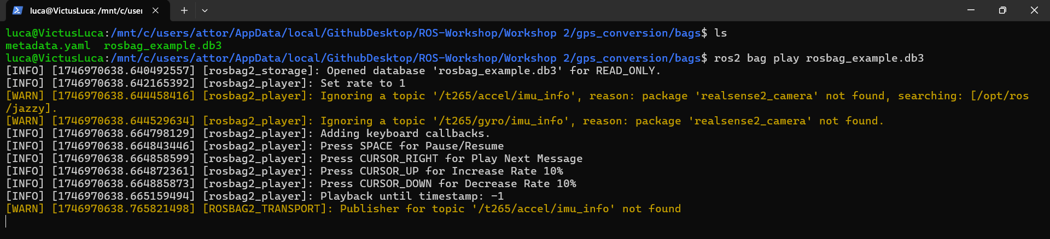
Play the bag
Don’t worry about the warning, they are there because we didn’t install a package needed to elaborate some of the messages inside the bag (not the ones that interests us)

Slide 47
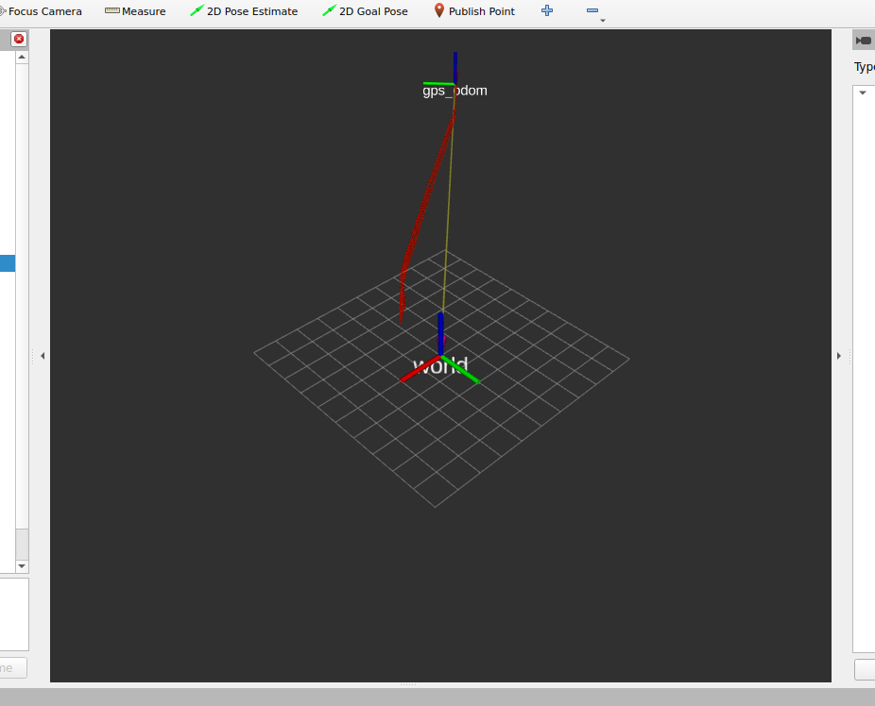
What you should see

Slide 48
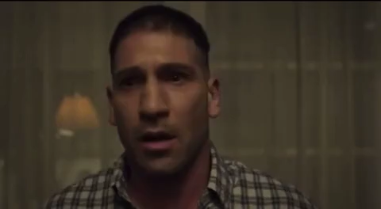
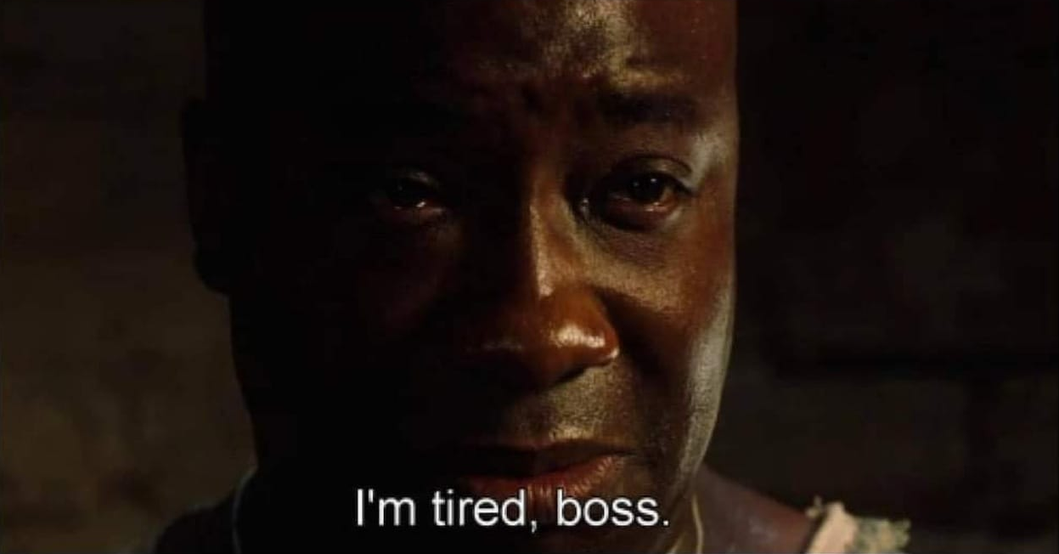
Thank you for the attention!
…But we’re not done yet

Slide 49
Multiple sensors
What happens if we have multiple sensors sending odometry data?
Do we have to write a node for each of them?
The answer is NO: we can reuse odom_to_tf

Slide 50
Remapping
This is possible thanks to the Remapping.
We can write a generic node to execute a function (in our case, convert from odom to tf).
Each time we need it, we launch the same node with different parameters: this is remapping.

Slide 51
Remapping
In the launch folder, you can find a 2° launch file called conversion_launch_wheel.py
It’s the same code as before, but this time we use it to convert from the wheel frame (instead of gps) to the global

Slide 52
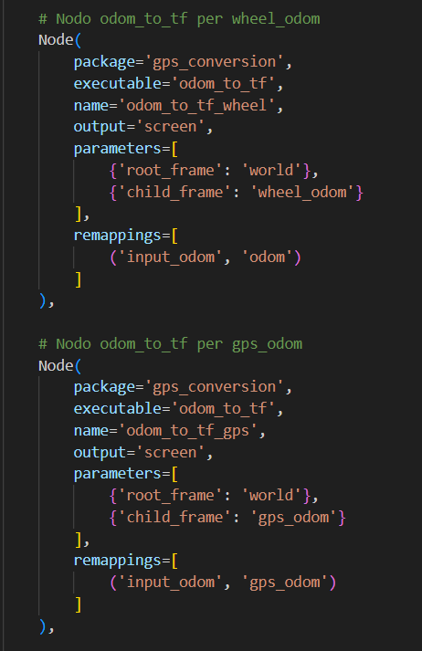
Remapping
You can see the remapping from the generic topic «Input_odom» to the sensor-specific one
NB: the two nodes should be launched with different names

Slide 53
Remapping
Try using this new launch file:
In Rviz insert the TF as before, you should see the wheel_frame
If you try running the bag you can notice a strange behaviour... Any idea on why?

Slide 54
Thank you!
We hope to see you on 16th May in B15 LM4 to discover the world of navigation and complete the workshop.

